Slide 1
8
Disk Storage, Basic File Structures, and Hashing

Slide 2
8.5 RAID

Slide 3
RAID
RAID: Redundant Arrays of Independent Disks
disk organization techniques that manage a large numbers of disks, providing a view of a single disk of
high capacity and high speed by using multiple disks in parallel,
high reliability by storing data redundantly, so that data can be recovered even if a disk fails

Slide 4
RAID
The chance that some disk out of a set of N disks will fail is much higher than the chance that a specific single disk will fail.
E.g., a system with 100 disks, each with MTTF of 100,000 hours (approx. 11 years), will have a system MTTF of 1000 hours (approx. 41 days)
Techniques for using redundancy to avoid data loss are critical with large numbers of disks

Slide 5
Improvement of Reliability via Redundancy
Redundancy
store extra information that can be used to rebuild information lost in a disk failure
E.g., Mirroring (or shadowing)
Duplicate every disk. Logical disk consists of two physical disks.
Every write is carried out on both disks
Reads can take place from either disk

Slide 6
Improvement of Reliability via Redundancy
Redundancy: E.g., Mirroring (or shadowing)
If one disk in a pair fails, data still available in the other
Data loss would occur only if a disk fails, and its mirror disk also fails before the system is repaired
Probability of combined event is very small
Mean time to data loss depends on mean time to failure, and mean time to repair
E.g., MTTF of 100,000 hours, mean time to repair of 10 hours gives mean time to data loss of 500*10⁶ hours (or 57,000 years) for a mirrored pair of disks (ignoring dependent failure modes)
Notes:
Probability of combined event is very small Except for dependent failure modes such as fire or building collapse or electrical power surges

Slide 7
Improvement in Performance via Parallelism
Two main goals of parallelism in a disk system:
1. Load balance multiple small accesses to increase throughput
2. Parallelize large accesses to reduce response time.
Improve transfer rate by striping data across multiple disks.

Slide 8
Improvement in Performance via Parallelism
Bit-level striping – split the bits of each byte across multiple disks
In an array of eight disks, write bit i of each byte to disk i.
Each access can read data at eight times the rate of a single disk.
But seek/access time worse than for a single disk
Bit level striping is not used much any more
Block-level striping – with n disks, block i of a file goes to disk (i mod n) + 1
Requests for different blocks can run in parallel if the blocks reside on different disks
A request for a long sequence of blocks can utilize all disks in parallel

Slide 9
Disk reliability: why RAID technology?
Hard drive performance lags CPU performance
Hard drive reliability is poor
RAID can boost both performance and reliability of disks

Slide 10
What does RAID provide
Performance
Parallelism
Load Balancing
Availability
Redundancy:
Mirroring, or Striping with Parity
Flexibility
Selectable Performance/Availability/Cost

Slide 11
What is RAID?
Redundant Array of Independent Disks (a.k.a. “Disk Array”)
Originally: Redundant Array of Inexpensive Disks
Multiple drives, single host disk unit
Provides opportunity to increase:
Performance via Parallelism
Data Availability via Redundancy
Cheap cost via commodity disks

Slide 12
History of RAID
Original paper:
A Case for Redundant Arrays of Inexpensive Disks (RAID) by D. Patterson, G. Gibson, R. Katz - 1987
Presented 6 types of RAID solutions:
RAID 0 to RAID 5
Companies afterward introduced several more RAID 6, 10, etc.

Slide 13
RAID 0
Spread data over multiple disk drives:
STRIPING
Advantage
Simple to implement
Fast
Disadvantage
Very unreliable: RAID 0 with n disks has MTTF equal to 1/n of MTTF of a single disk

Slide 14









RAID 0
Each drive stores a consecutive chunk of data (chunk size is configurable - usually 1 sector)
If any disk fails, all data is corrupted
Drive
1
Drive
2
Drive
3
Drive
4
Drive
5
Chunk 0
Chunk 5
Chunk 10
Chunk 15
Chunk 20
Chunk 1
Chunk 6
Chunk 11
Chunk 16
Chunk 21
Chunk 2
Chunk 7
Chunk 12
Chunk 17
Chunk 22
Chunk 3
Chunk 8
Chunk 13
Chunk 18
Chunk 23
Chunk 4
Chunk 9
Chunk 14
Chunk 19
Chunk 24
Parity

Slide 15
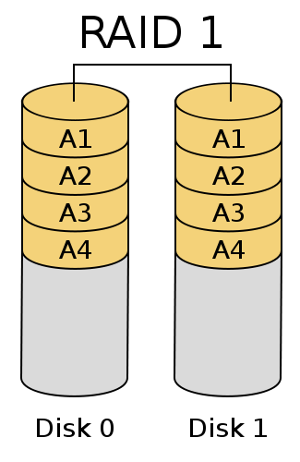
RAID 1
Each drive stores same data, one copy per drive:
MIRRORING
Advantages
Simple to implement
Fault-tolerant
Disadvantage
Requires n times the disk capacity of normal file systems, where n is the number of replications (= disks)

Slide 16
RAID 2
Data is striped at 1 bit granularity
In addition, we use error correcting code (detect 2, correct 1 bit error) to protect from failures
Provides both BANDWIDTH and RELIABILITY
But: you need a lot of disks!

Slide 17
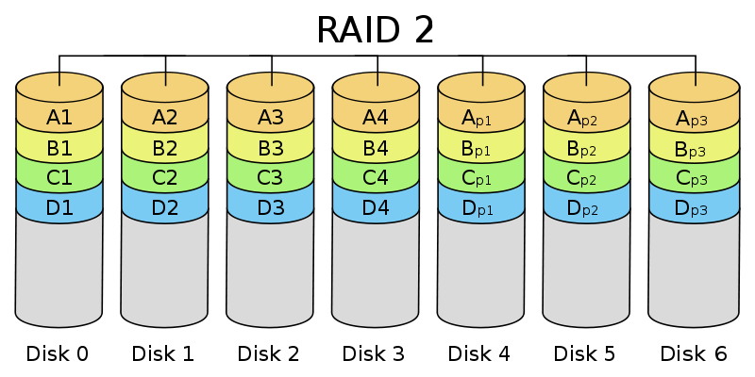
RAID 2
1 bit

Slide 18
RAID 3
Data is striped at 1 byte granularity
In addition, one disk is dedicated to store 1 parity byte for each stripe
Requires N+1 disk drives
N drives contain data – striped with 1 byte granularity
Parity drive contains exclusive or of these N fragments
p[k] = b[k,1] ⊕ b[k,2] ⊕ ... ⊕ b[k,N]

Slide 19









RAID 3
Improves over RAID 2:
Parity instead of ECC: requires fewer drives and can still recover one disk if it knows which disk failed
Coarser store granularity
Drive
1
Drive
2
Drive
3
Drive
4
Drive
5
Byte 0
Byte 4
Byte 8
Byte 12
Byte 16
Byte 1
Byte 5
Byte 9
Byte 13
Byte 17
Byte 2
Byte 6
Byte 10
Byte 14
Byte 18
Byte 3
Byte 7
Byte 11
Byte 15
Byte 19
Parity
Parity
Parity
Parity
Parity
Parity

Slide 20
RAID 4
Same as RAID 3 but data is stored in chunks, larger than a byte
Usually 1 sector long
Improves on store/read performance
Same performance bottleneck as 3:
all loads and stores need to access the same disk

Slide 21
RAID 5
RAID 5 similar to 4, but removes the bottleneck on the parity disk
Parity bytes are stored in different disks for different stripes
RAID-5 distributes the parity blocks among the N+1 drives
Advantages:
Multiple read/write operations in parallel are possible
Fault tolerant against 1 disk failure

Slide 22
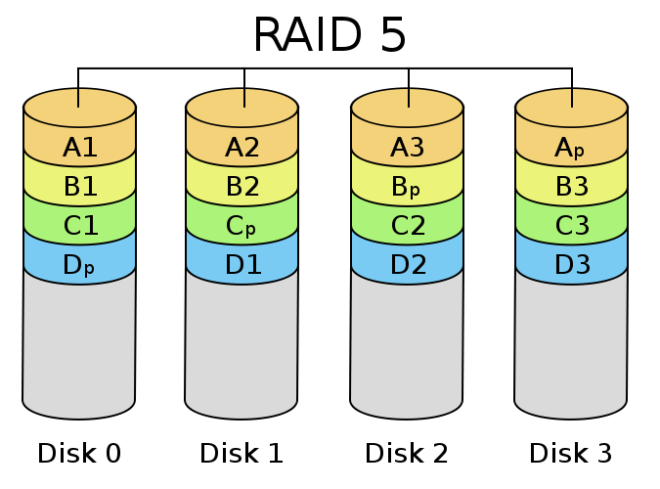
RAID 5
25% parity
75% data

Slide 23
RAID 5 still has one issue
SMALL WRITE PROBLEM of RAID 5:
Happens when we want to update a single block
Block belongs to a stripe
How can we compute the new value of the parity block
b[k]
b[k+1]
b[k+2]
...
p[k]

Slide 24
First Solution
Read values of N-1 other blocks in stripe
Recompute
p[k] = b[k] ⊕ b[k+1] ⊕ ... ⊕ b[k+N-1]
Solution requires
N-1 reads
2 writes (new block and parity block)

Slide 25
Better Solution
Assume we want to update block b[m]
Read old values of b[m] and parity block p[k]
Compute
p[k] = new b[m] ⊕ old b[m] ⊕ old p[k]
Solution requires
2 reads (old values of block and parity block)
2 writes (new block and parity block)

Slide 26









Better solution illustrated
3.
XOR old and new data to create Partial Product
5.
XOR old parity with partial product, writing out result as new parity
4.
Read
old parity data
1. Read
old data.
2.
Write new data
} XOR
} XOR
New
P. P.
Old P.
New P.
Old
Drive
1
Drive
2
Drive
3
Drive
4
Drive
5
Chunk 0
Chunk 1
Chunk 2
Chunk 3
Parity

Slide 27
RAID Review
RAID 0 - Data striping, Non-redundant.
High Performance, Low Reliability
RAID 1 - Mirroring
Moderate Performance, Expensive High Reliability
RAID 4 - Striping, single parity disk.
High Bandwidth Performance, Cheap Availability
RAID 5 - Striping, rotating parity disk.
High Throughput Performance, Cheap Availability

Slide 28
RAID 6
Data striping with two rotating parity disks
Advantage
Higher reliability: can recover from the failure of 2 disks
Disadvantage:
Cost

Slide 29
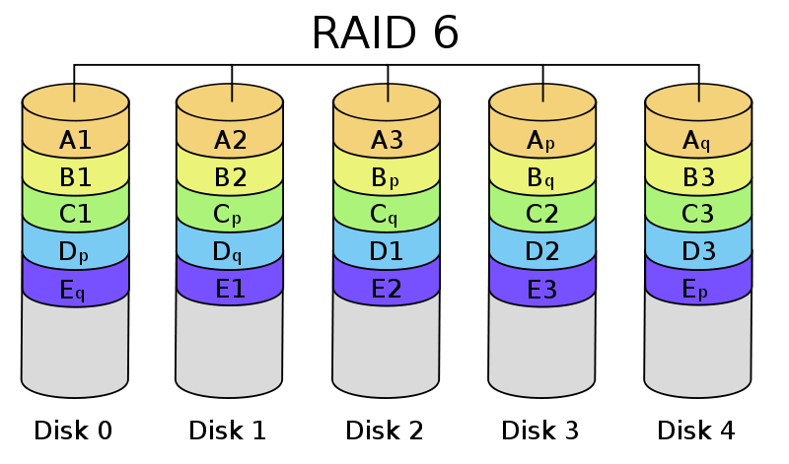
RAID 6

Slide 30
Additional improvements
Hot spare:
Used to compute (recover) data when one disk fails. After data is recomputed, the hot spare replaces the failed disk
Nested or hybrid RAID
Nesting of (usually) two RAID levels
E.g.: RAID 10 = RAID 1 of disks organized in RAID 0 structure
Implementation: can be HW or SW (cheaper)
Linux has drivers to manage disks in RAID fashion

Slide 31
RAID Summary
Goal: Reducing performance gap between CPU and I/O
Data availability also a priority
RAID meets the I/O challenge:
Performance via parallelism
Data availability via redundancy
Flexibility via multiple RAID levels, each offer unique performance/availability/cost tradeoffs

Slide 32
Choice of RAID Level
Factors in choosing RAID level
Monetary cost
Performance: Number of I/O operations per second, and bandwidth during normal operation
Performance during failure
Performance during rebuild of failed disk
Including time taken to rebuild failed disk
RAID 0 is used only when data safety is not important
E.g., data can be recovered quickly from other sources

Slide 33
Choice of RAID Level (Cont.)
Level 1 provides much better write performance than level 5
Level 5 requires at least 2 block reads and 2 block writes to write a single block, whereas Level 1 only requires 2 block writes
Level 1 had higher storage cost than level 5
Level 5 is preferred for applications where writes are sequential and large (many blocks), and need large amounts of data storage
RAID 1 is preferred for applications with many random/small updates
Level 6 gives better data protection than RAID 5 since it can tolerate two disk (or disk block) failures
Increasing in importance since latent block failures on one disk, coupled with a failure of another disk can result in data loss with RAID 1 and RAID 5.

Slide 34
Hardware Issues
Software RAID: RAID implementations done entirely in software, with no special hardware support
Hardware RAID: RAID implementations with special hardware
Use non-volatile RAM to record writes that are being executed
Beware: power failure during write can result in corrupted disk
E.g., failure after writing one block but before writing the second in a mirrored system
Such corrupted data must be detected when power is restored
Recovery from corruption is similar to recovery from failed disk
NV-RAM helps to efficiently detected potentially corrupted blocks
Otherwise all blocks of disk must be read and compared with mirror/parity block

Slide 35
Hardware Issues (Cont.)
Latent failures: data successfully written earlier gets damaged
can result in data loss even if only one disk fails
Data scrubbing:
continually scan for latent failures, and recover from copy/parity
Hot swapping: replacement of disk while system is running, without power down
Supported by some hardware RAID systems,
reduces time to recovery, and improves availability greatly
Many systems maintain spare disks which are kept online, and used as replacements for failed disks immediately on detection of failure
Reduces time to recovery greatly
Many hardware RAID systems ensure that a single point of failure will not stop the functioning of the system by using
Redundant power supplies with battery backup
Multiple controllers and multiple interconnections to guard against controller/interconnection failures

